Slide 1
Riddle Me This…
Riddle Me That…
What do plants cells have
that animal cells do not?

Slide 2
The Answer…
Cell wall!
Turgor pressure - the pressure exerted when water collects in the plant cell and pushes against the cell wall.
This is how plants gain strength to stand upright.

Slide 3
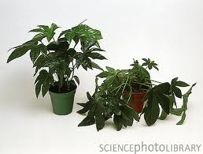
Turgor Pressure
Healthy plant cells are turgid and plants rely on turgidity to maintain rigidity.
So… which plant
would have a
higher turgor
pressure?

Slide 4
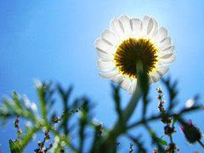

Tropism – Plant movement towards or away from a stimulus.
To turn
+ Positive Tropism = To turn towards a stimulus
- Negative Tropism = To turn away from a stimulus

Slide 5
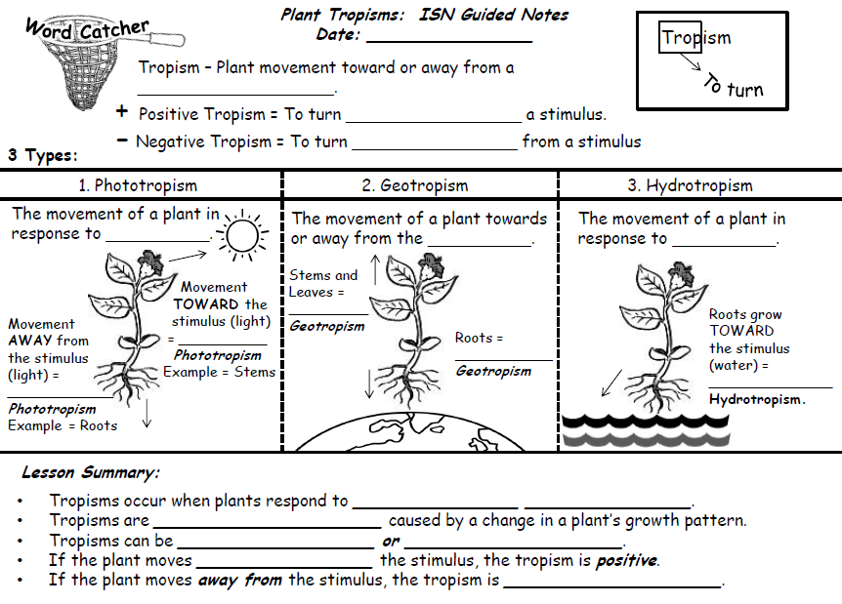

Slide 6


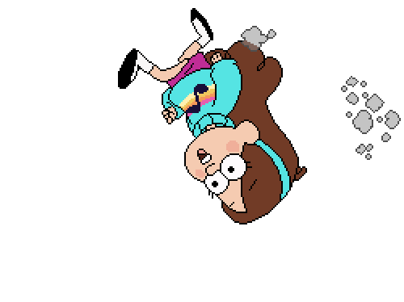
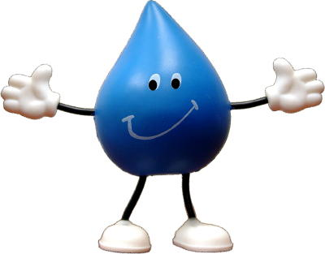
3 types of tropisms in plants
Phototropism
Geotropism
Hydrotropism

Slide 7
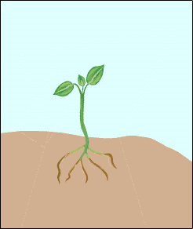
Phototropism
Remember:
Movement TOWARD the stimulus (light) = Positive Phototropism
Example = Stems
Movement AWAY from the stimulus (light) = Negative Phototropism Example = Roots
The movement of a plant in response to light.

Slide 8
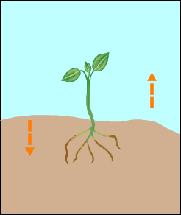
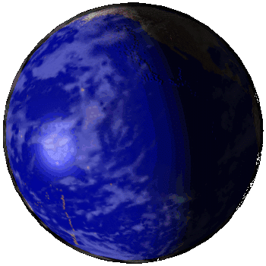
Geotropism
Movement towards or away from the Earth.
Geo
=
Earth
Stems and Leaves = Negative Geotropism
Also called gravitropism!
Roots =
Positive Geotropism

Slide 9
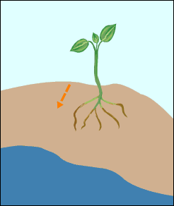
Roots grow
TOWARD
the stimulus (water) =
Positive Hydrotropism.
hydrotropism
A
plant's
movement
In
response
To
water.
Hydro = water

Slide 10
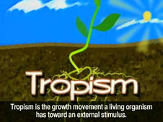
Did you know?
Tropism - (Greek for ‘a turning’)
A turning growth or movement
of a plant in response
to an environmental stimulus.

Slide 11
Did you know?
Tropisms can be positive and negative…
positive – plant moves in the direction of stimulus
negative – plants move away from stimulus

Slide 12
Tropisms of plants
Gravitropism – response to gravity
Thigmotropism – response to contact/touch
Heliotropism – response to sunlight

Slide 13
Tropisms of plants
Phototropism – response to light or colors
Hydrotropism – response to water
Thermotropism – response to temperature

Slide 14
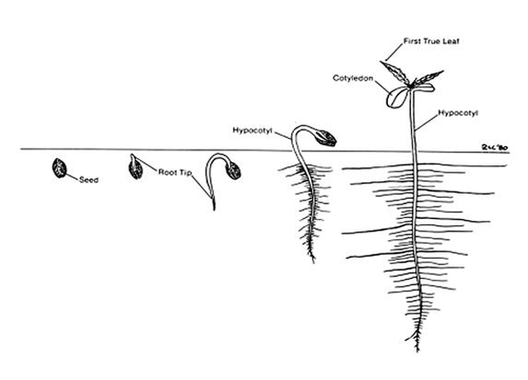
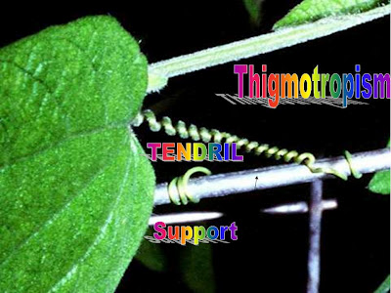
Tropisms of plants
Gravitropism –
response to gravity
Thigmotropism –
response to touch
or contact
(via tendrils)

Slide 15
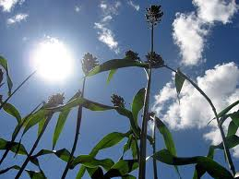
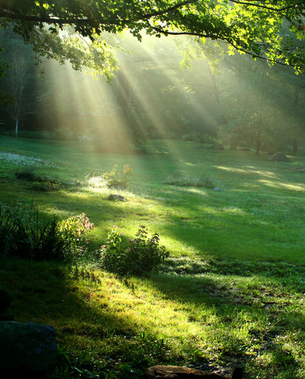
Tropisms of plants
Heliotropism –
response to
sunlight
Phototropism –
response to
light or colors

Slide 16
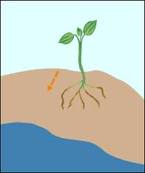
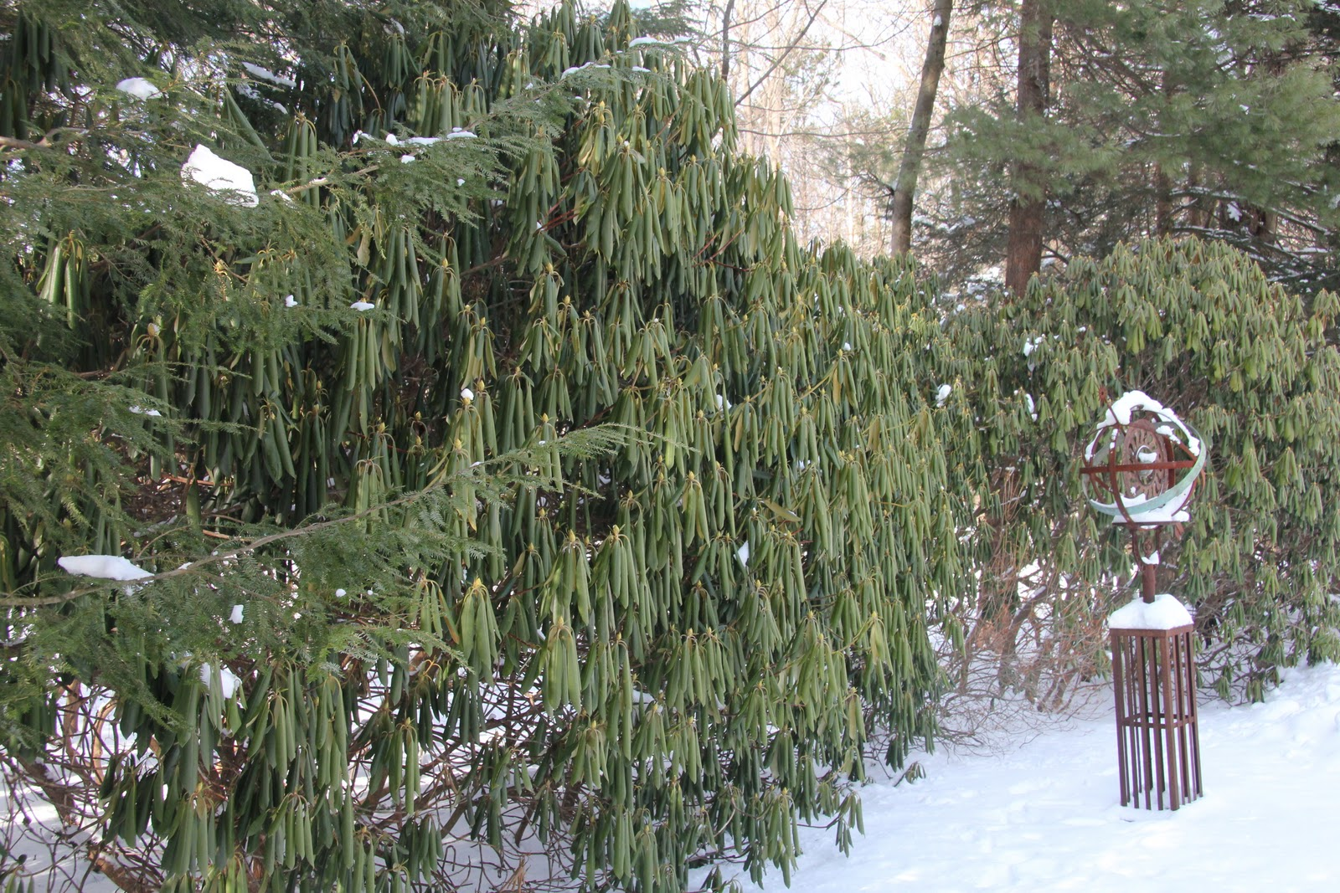
Tropisms of plants
Hydrotropism –
response to water
Thermotropism –
response to change
in temperature

Slide 17
Photoperiodism
Plants determine the time of year
by the length of daylight, known as
a photoperiod.
Photoperiodism is how a plant responds to a change in seasons.

Slide 18
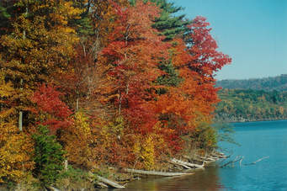
Photoperiodism
Because of the tilt of the Earth, during winter days, there are less hours of light than in summer.
Plants begins producing different
pigments and changing leaf colors.
2. Plants prepare for
dormancy – a period of
‘low metabolism’
to conserve energy

Slide 19
C₁₀H₁₆N₅O₁₃P₃
ATP

Slide 20
Lesson Summary:
Tropisms occur when plants respond to external stimuli.
Tropisms are movements caused by a change in a plant’s growth pattern.
Tropisms can be negative or positive.
If the plant moves toward the stimulus, the tropism is positive.
If the plant moves away from the stimulus, the tropism is negative.

Slide 21
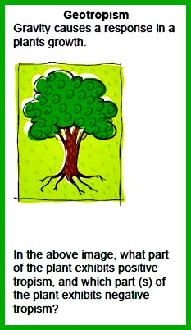
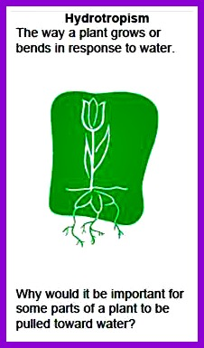
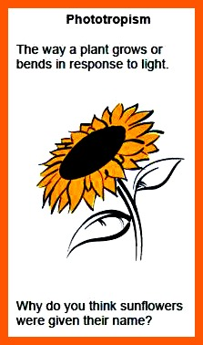
Check for understanding
Answer questions 1-3 on a notecard. Use complete sentences.
Question #1:
Question #2:
Question #3:

Slide 22
http://education-portal.com/academy/lesson/tropisms-phototropic-geotropic-and-thigmotropic-plant-growth.html
http://leavingbio.net/plant%20responses.htm

